Slide 1
Johns Hopkins Accountability Board
Orientation
June 24, 2025

Slide 2

Agenda
8:30 a.m. – Arrival and Breakfast
9:00 a.m. – Welcome
9:05 a.m. – Opening Remarks & Introduction of Facilitators
9:10 a.m. – Ice Breaker
9:40 am – Overview of Community Safety & Strengthening Act & Police Accountability in Baltimore City
10:00 a.m. – Overview of Committee Descriptions and JHPAB Updates
10:10 a.m. – 10-Minute Break
10:20 a.m. – Great Expectations
  “How to Be an Effective Board Member”
11:30 a.m. – GAP Training
12:00 p.m. – Lunch
12:45 p.m. – History of Oversight
  Team Building Activity
2:15 p.m. – Break
2:30 p.m. – Scenario-Based Learning
4:30 p.m. – Questions/Next Steps
4:45 p.m. – Closing Remarks

Slide 3
Aprille Weron – Johns Hopkins Police Accountability Board Chair

Slide 4
Dr. Branville Bard – Vice President for Public Safety & Chief of Police
Calvin L. Smith Jr. – Deputy Chief of Staff for Public Safety
Opening Remarks & Introduction of Facilitators

Slide 5
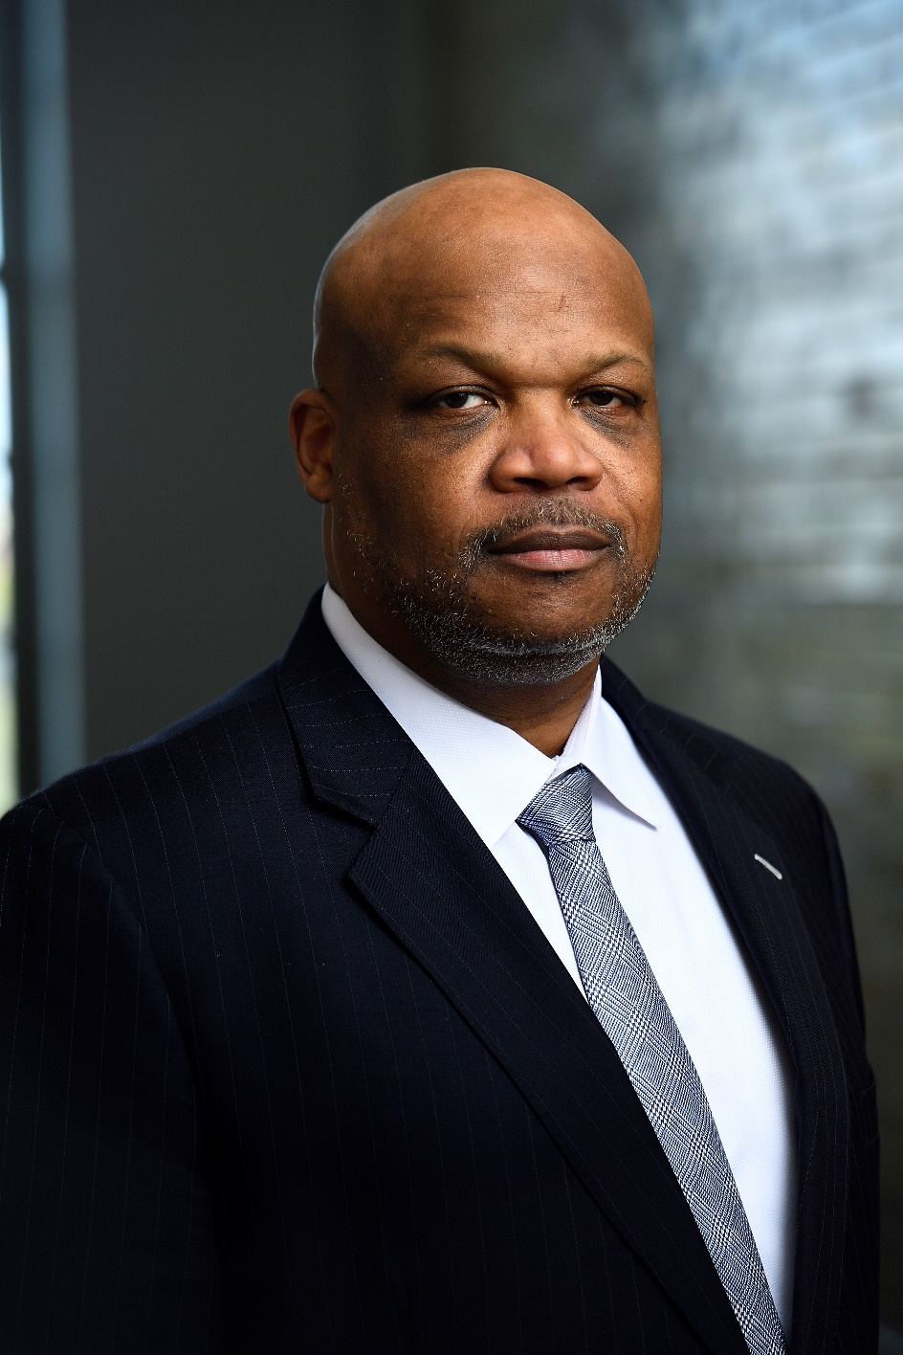
Dr. Branville G. Bard, Jr. Vice President for Public Safety and Chief of the Johns Hopkins Police Department (JHPD)

Slide 6
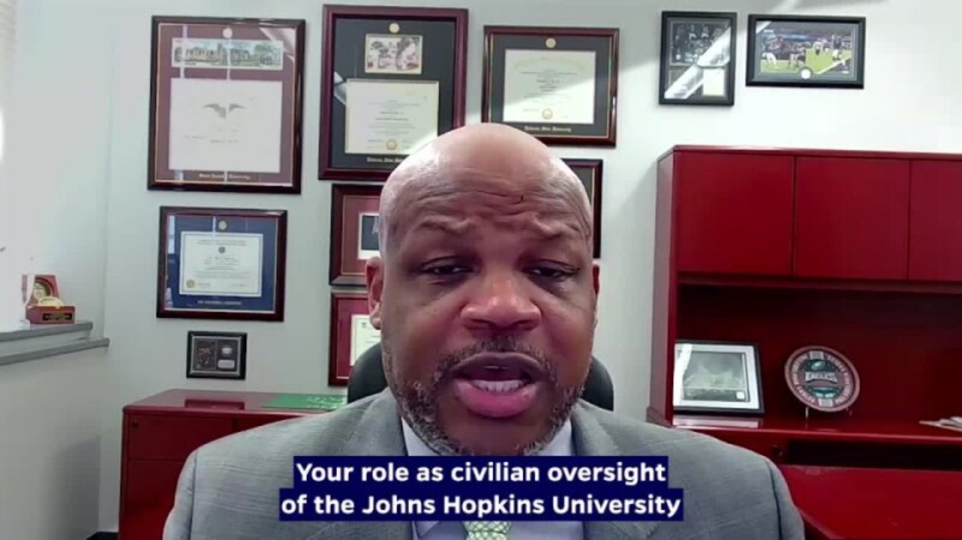
Dr. Branville G. Bard, Jr. Vice President for Public Safety and Chief of the Johns Hopkins Police Department (JHPD)

Slide 7
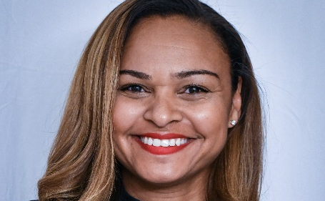
Ganesha Martin
Ganesha Martin, Esq., is a police reform expert who recently joined Mark43, the leading cloud-native public safety software company, as Vice President of Public Policy and Community Affairs. In her role, Martin focuses on Mark43’s ongoing commitment to innovation in technology designed to empower police to better serve their communities through accountability, transparency, and trust-building. Before taking on this role, she held several positions in the Baltimore City government. Most recently, she was the Director of the Mayor’s Office of Criminal Justice (MOCJ). She has overseen collaborative criminal justice efforts that included the Baltimore Police Department, Baltimore State’s Attorney’s Office, Governor’s Office of Crime Control and Prevention, Department of Justice Civil Rights Division, U.S. Attorney’s Office, the judiciary, and several community groups.
In her current consulting practice, Martin focuses on uniting communities of color and the police who swear to serve and protect them. Her unique ability to connect with both the community and the police, guiding them towards common ground, is the hallmark of her success. In addition to Baltimore, she has consulted on consent decree compliance and police reform matters for police departments nationwide. An expert on public safety, best practices for building relationships between community and police, she regularly advises nonprofit organizations, real estate developers, tech startups, private corporations, community groups, and local governments.
A highly sought-after expert on police reform, Martin regularly speaks on DOJ Consent Decrees, police reform and accountability, and public safety. She’s a member of the Council on Criminal Justice, an invite-only, nonpartisan organization and think tank for leaders in the criminal justice field. She was recently elected to the Board of Directors for the National Criminal Justice Association. In 2019, she was one of 40 community policing experts invited to Nairobi, Kenya, to share community policing strategies at the Convening on Civilian Police Reform, hosted by the Open Society Foundation. She was also awarded the Securing Open Societies Fellowship in 2019. Martin’s expert commentary has been featured in The New York Times, The Baltimore Sun, USA Today, and the Washington Post, among others.

Slide 8
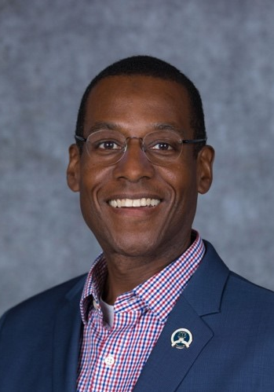
Brian Corr
Brian Corr has worked for the City of Cambridge, Massachusetts as Executive Director of the Police Review & Advisory Board since September 2010, and as Executive Director of the city's Peace Commission since 2008. The Police Review & Advisory Board is the city’s civilian oversight agency, while the Peace Commission works with other municipal agencies, communities of faith, and nonprofit organizations to promote positive dialogue, foster understanding, and coordinate compassionate community responses to support recovery and healing in the wake of traumatic events and violence affecting Cambridge and its residents.
Brian serves as vice-chair of the board of directors of Community Resources for Justice, which works to change lives and strengthen communities by advancing policy and delivering individualized services that promote safety, justice, and inclusion. He also serves on the boards of the American Friends Service Committee, Central Square Theater, the Jose Mateo Ballet Theatre, and Eureka Ensemble, and the DiDomenico Foundation.
He has served as an elected member of the Massachusetts Democratic State Committee since 2012, served as a delegate to the 2020 and 2024 Democratic National Conventions, and served as a member of the 2024 Electoral College from Massachusetts. Brian has chaired the advisory board of the Haiti Development Studies Center at the University of Massachusetts since 2016.
He is past president of the National Association for Civilian Oversight of Law Enforcement (NACOLE) and has earned their Certified Practitioner of Oversight credential. He served as treasurer of the Massachusetts chapter of the National Organization of Black Law Enforcement Executives (NOBLE) from 2019 to 2023.
Brian also holds certifications in Group Crisis Intervention and Post-Traumatic Stress Management/Psychological First Aid and has completed the Police Chaplain Twelve Core Courses Training through the International Conference of Police Chaplains. He has also completed a 35-hour train-the-trainer session in Trauma-Informed Policing. He graduated with a B.A. in Russian Literature and Language from the University of Michigan in 1986 and has completed the Negotiation and Leadership course at the Program on Negotiation at Harvard Law School.

Slide 9
Co-Facilitators Ganesha Martin, Esq & Brian Corr, CPO
Ice Breakers

Slide 10
Community Safety and Strengthening Act (Senate Bill 793)
Calvin L. Smith, Jr.

Slide 11
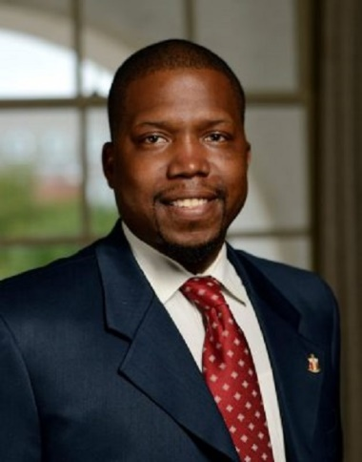
Calvin L. Smith, Jr.
Calvin L. Smith, Jr., currently serves as the deputy chief of staff for Johns Hopkins Public Safety. He manages cross-functional initiatives and advances JHPS's strategic direction, specifically supporting all Johns Hopkins University functions related to Public Safety. Additionally, he is responsible for directly supporting the Johns Hopkins Accountability Board.
Most recently, Calvin led the Leadership Engagement & Experiential Development (LEED) team. He oversaw the LEED office's day-to-day operations, including Leadership Development, Fraternity and Sorority Life, Student Organizations, Student Government Association, Student Lecture Series, Programming Boards, Large-Scale University Programming/Traditions, Protests, and Demonstrations, and the selection, implementation, and expansion of the student engagement platform Hopkins Groups. Calvin worked to ensure students had meaningful opportunities to engage, lead, and develop with the campus and greater Baltimore community through their student organizational experience.
Previously, Calvin was the director of Fraternity and Sorority Life at Johns Hopkins University, an established fraternity and sorority community dating back to 1877. The community currently has over 27 chapters comprised of approximately 1500 students, which makes up 30% of the undergraduate population at JHU. Additionally, he was coordinator of Fraternity and Sorority Life at Towson University. While at Towson, Calvin advised over 34 chapters comprised of approximately 2600 students. He primarily focuses on the overall development and growth of nationally recognized fraternities and sororities on campus. He began his career in pharmaceutical and corporate sales, marketing, and management for six years before transitioning into higher education in the fall of 2011.
Calvin L. Smith, Jr., a Norfolk, Virginia native, holds a B.S. from the Alfred Lerner College of Business and Economics at the University of Delaware and an MBA from the Earl G. Graves School of Business and Management at Morgan State University.

Slide 12
Community Safety and Strengthening Act
Overview
Chapter 25 of 2019 (Senate Bill 793)
Took effect July 1, 2019
Two main components:
  Community investments to help address root causes of crime; and
  Authorization for the Johns Hopkins Police Department

Slide 13
Community Safety and Strengthening Act
JHPD Operations
Police Department established based on MOU between JHU and the Baltimore Police Department with community input
Department may operate on East Baltimore, Homewood, and Peabody campuses
May operate in areas adjacent to campus ONLY IF:
Receive a majority of support from relevant community; and
  Baltimore City Council approves a resolution affirming JHU has received the required support of the community
  Subject to standards to ensure constitutional and community-oriented policing

Slide 14
Community Safety and Strengthening Act
Public Accountability
Must establish a University Police Accountability Board
  Fifteen-member board with five seats for the community
  Will review department metrics and policies and make recommendations
Subject to the jurisdiction of the Police Accountability Board and the Administrative Charging Committee of Baltimore City
Administrative Charging Committee must have two voting members of the public
Must establish a public complaint process
No civil immunity in department court cases

Slide 15
Community Safety and Strengthening Act
Role of the Johns Hopkins Accountability Board
Has authority to:
  (1) Review JHPD metrics involving crime
  (2) Review current/prospective PD policies, procedures, training
  (3) Provide recommendations to JHU on the above
Must meet at least quarterly
Must post its meeting minutes prominently on a public website
Must hold at least one public meeting annually “to seek input on police department policies, procedures, and training from community members of Baltimore City”
Once JHPD is established, it must acknowledge and respond to any recommendation from the Board within 120 days
Notes:
https://publicsafety.jhu.edu/clery-and-crime-data/crime-fire-logs/

Slide 16
Police Accountability in Baltimore City
Calvin L. Smith, Jr.

Slide 17

Baltimore City Police Accountability Board

Slide 18
Baltimore City PAB
Police Accountability Board Baltimore City Code Article 1, § 11-7.
The Board must:
(1) Hold quarterly meetings with the Chief of each law enforcement agency;
(2) Appoint civilian members to the administrative charging committee and trial boards;
(3) Receive complaints of police misconduct filed by a member of the public;
(4) Review the outcomes of disciplinary matters considered by the administrative charging committee every quarter, including JHPD.
(5) Advise the Mayor and the City Council on policing matters; and
(6) Refer each complaint of police misconduct filed with the Board to the appropriate law enforcement agency within 3 days after receipt for investigation.
Notes:
BPD
JHPD
Coppin State University
Morgan State University
University of Maryland at Baltimore
BCPSS Police

Slide 19
Administrative Charging Committee

Slide 20
Administrative Charging Committee
Administrative Charging Committee, BCC Article 1, § 11-10(H)
The Committee must:
(i) Review the findings of each law enforcement agency's investigation forwarded by the agency to the Committee;
(ii) Review any body camera footage that may be relevant to the matters covered in the complaint of police misconduct;
(iii) Authorize a police officer called before the Committee to be accompanied by a representative;
(iv) Within 30 days after receipt of the law enforcement agency's investigatory file, unless the Committee requests further review under subsection (g) of this section, determine if the police officer who is the subject of the charged investigation should be administratively charged or not administratively charged;
Notes:
The Committee comprises 5 members, of which:
(i) 1 is the Chair of the Police Accountability Board, or another member of the Board designated by the Chair;
(ii) 2 are civilian members appointed by the Police Accountability Board; and
(iii) 2 are civilian members appointed by the Mayor.

Slide 21
Administrative Charging Committee
Administrative Charging Committee, BCC Article 1, § 11-10(H)
The Committee must:
(v) If the Committee determines that a police officer should be administratively charged, recommend discipline pursuant to the disciplinary matrix;
(vi) If the Committee determines that a police officer should not be administratively charged, make a determination that:
(A) The allegations against the police officer are unfounded, or
(B) The police officer is exonerated.
(vii) Issue a written opinion for each complaint describing in detail the Committee's findings, determinations, and recommendations; and
(viii) Forward the written opinion to the Chief of the appropriate law enforcement agency, the accused police officer, and the complainant.

Slide 22
Johns Hopkins Police Accountability Board

Slide 23
JH Police Accountability Board
Johns Hopkins Accountability Board, MD Code Ann., Educ. § 24-1205
(b) The purpose of the Accountability Board is to:
(1) Enable community members to share community concerns regarding the police department directly with police department leadership;
(2) Review police department metrics;
(3) Provide feedback on existing police department policies and practices, including police department standards for hiring and recruitment; and
(4) Suggest ideas for improving police department policies, procedures, and performance, including ideas for community-based public safety initiatives.

Slide 24
JH Police Accountability Board
Md. Code Ann., Educ. § 24-1205 (West)
(d) The Accountability Board shall have the authority to:
(1) Review police department metrics involving crime.
(2) Review current and prospective police department policies, procedures, and training; and
(3) Provide recommendations to the University on current and prospective police department policies, procedures, and training.

Slide 25
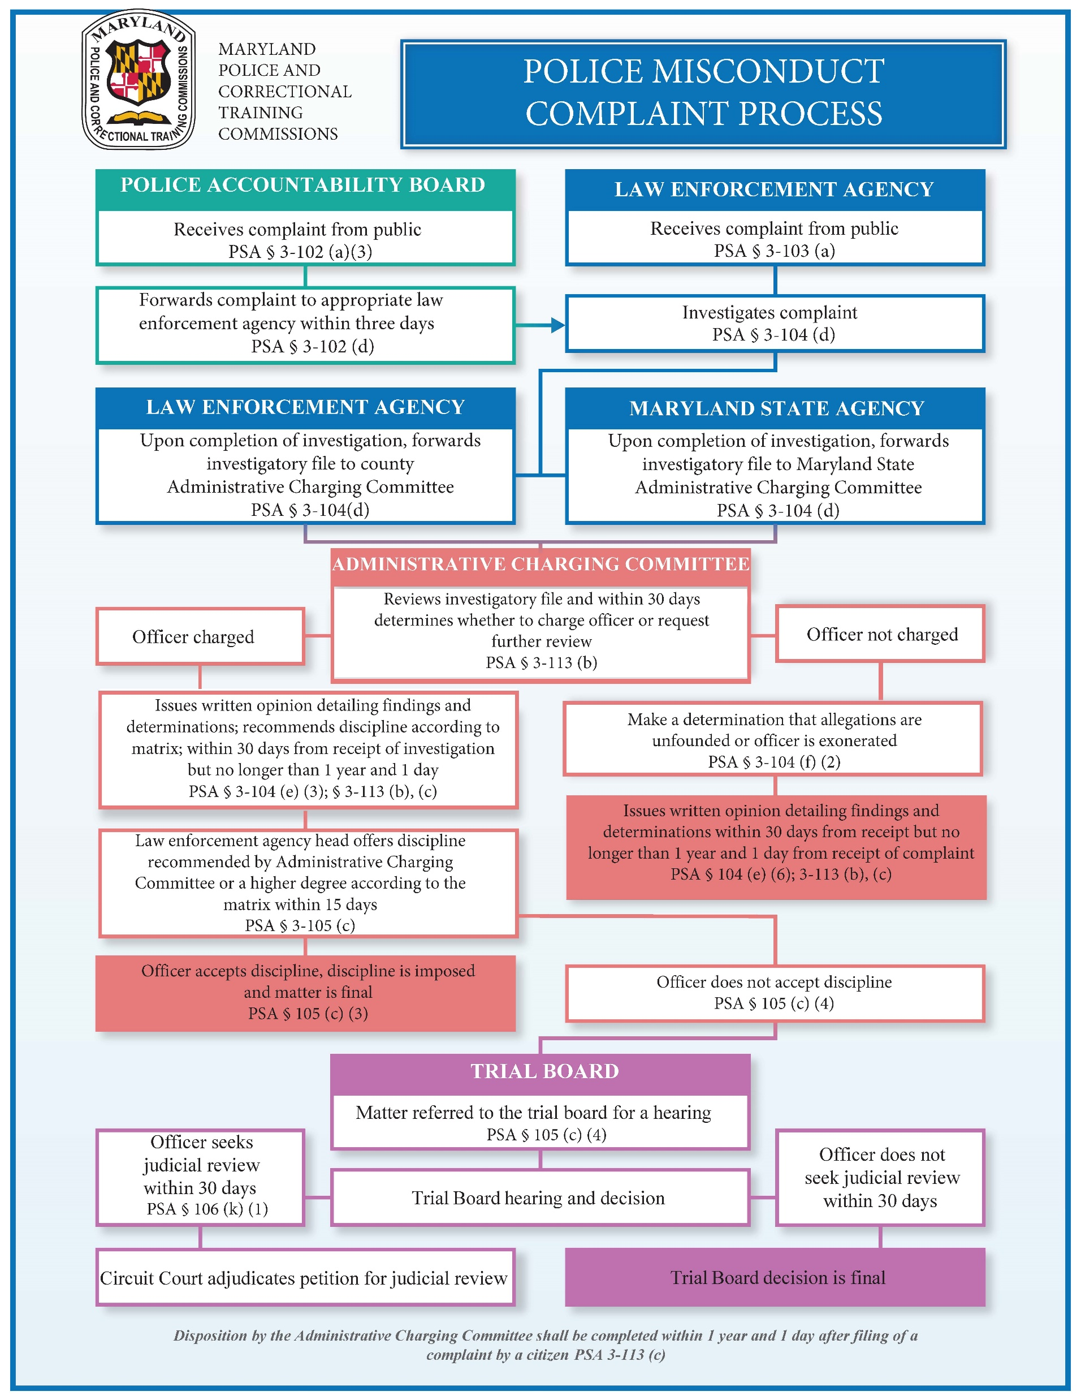
Police Misconduct Process
The PAB & JHAB can receive complaints and forward them to agencies
The AAC reviews the findings, investigates, and recommends charges.
Agency Head offers discipline recommended by the AAC or something higher.
Notes:
Review the findings of each law enforcement agency's investigation forwarded by the agency to the Committee, review any body camera footage that may be relevant to the matters covered in the complaint of police misconduct, authorize a police officer called before the Committee to be accompanied by a representative, determine if the police officer who is the subject of the charged investigation should be administratively charged or not administratively charged within 30 days after receipt of the investigatory file, recommend discipline if the police officer is administratively charged, make a determination if the police officer is not administratively charged, issue a written opinion for each complaint describing the Committee's findings, determinations, and recommendations, forward the written opinion to the Chief of the appropriate law enforcement agency, the accused police officer, and the complainant

Slide 26
Aprille Weron
Overview of Committee Descriptions and Updates

Slide 27


Data Committee
Chair: Elizabeth Hazel
Role: Analyze and propose recommendations based on the regularly reported crime and police conduct data; aim for transparency in policing metrics to support accountability to communities.

Slide 28

Governance Committee
Chair: Jerrell Bratcher
Role: Analyze and propose recommendations based on the JHPD’s adherence to state and local laws. Specifically, the Community Safety & Strengthening Act, which established the JHPD.

Slide 29

Policy Committee
Chair: Vacant
Role: Analyze and propose policy recommendations to improve the functioning of the JHPD.

Slide 30


Training Committee
Chair: Laura Rossi
Role: Analyze and propose training recommendations to improve the functioning of the JHPD.

Slide 31

Community Engagement Committee
Chair: Sonja Merchant Jones
Role: Analyze and propose recommendations to improve the relationship between the JHPD and the Baltimore community, to which it serves.

Slide 32
10-Minute Break

Slide 33
Great Expectations
“How to be an Effective Board Member”
Brian Corr, CPO

Slide 34
Phil Kasten, Sr.
GAP Training Update

Slide 35
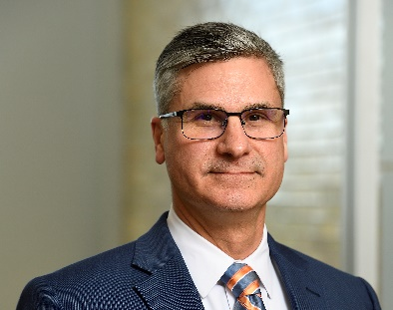
Phil Kasten
Phillip Kasten is the Sr. Director for Compliance and Training with Johns Hopkins Public Safety, where he oversees policy development and the entry-level and advanced training of public safety personnel in accordance with the many professional standards governing each of these areas.
A career law enforcement officer with 30 years of progressively responsible public safety experience, Phil most recently served as Chief of Police for the Town of Hartford, Vermont, where his collaborative work in support of the region’s vulnerable populations led to his appointment as a member of the Board of Directors for Heath Care & Rehabilitative Services, the designated community mental health and human service provider for Southeastern Vermont. A Maryland native, Phil began his law enforcement career as a police officer with the Town of Hampstead and later joined Carroll County’s rapidly expanding Sheriff’s Office, where he worked in several operational, investigative, and administrative roles before his appointment as Chief Deputy of the Sheriff’s Office.
Phil has also served as a United States Marine. he holds a Master’s Degree in Criminal Justice & Crime Prevention from the University of Cincinnati. He is a graduate of the FBI National Academy. Phil has also held leadership positions with several professional associations, including serving for more than ten years as an assessor and assessment team leader for the Commission on Accreditation for Law Enforcement Agencies (CALEA).

Slide 36
Policy Development & Review

Slide 37
Policy Development
Johns Hopkins undertook the most extensive policy development and feedback process for a police department at an institution of higher education.
JHPD focused on policy creation based on best practices and model policies from organizations including the Leadership Conference on Civil and Human Rights, the International Association of Chiefs of Police (IACP), and the Police Executive Research Forum (PERF)
  The ACLU’s “Racially Just Policing: Model Policies for Colleges and Universities”
  The Justice Collaboratory at Yale Law School’s “Principles of Procedurally Just Policing”
  President Obama’s Commission on 21st Century Policing
  The Standards for Law Enforcement Agencies by the Commission on Accreditation for Law Enforcement Agencies (CALEA)
Maryland Police Reform Legislation, Community Safety and Strengthening Act, judicial, The Baltimore City Police Consent Decree and the MOU between the BPD & JHPD

Slide 38
Policy Development & Review
While some university peers publish finalized policies online, they do not typically post any publicly accessible material regarding their policy development processes.
Each draft policy was prepared by an all Civilian JHPD Policy Drafting Group and was reviewed prior to being shared with the JH Accountability Board and being posted for public review:
  Vice President for Public Safety and Chief of Police,
  21CP Solutions, external Public Safety Consultant and
  Key members of the JHU Leadership Team and comment.
First drafts were posted to the JH Public Safety website, with a section for draft review and a prominent feedback button to assist with submitting input.

Slide 39


Policy Development & Review Process
JHPD prioritized and conducted community engagement before policy enactment…
Policies reviewed by JH Accountability Board, community, & outside experts
Policies drafted by internal & external policing experts
Policies posted online for a 60- day public comment period
Draft policies are updated to reflect community feedback
Final policies and feedback report posted on the Public Safety Website
The final JHPD policies and procedures, along with a disposition report detailing all community feedback received during the public comment period and how the comments were addressed within the final policies were posted to the Public Safety website on July 31, 2024.

Slide 40
Upcoming Policy for Review
Board members have, and will continue to be invited to share feedback on draft policies in writing and during the Board’s public meetings.
The Policy Drafting Group is currently reviewing all policies with the JHPD leadership team as they work to operationalize and implement the published policies. Along with some non-material changes, there are two new policies currently in the research and development process;
  The Campus Experience
  Trikke Personal Vehicle
A material update to the Fleet Management Policy is also in development to account for the addition of the E-Car. The publishing of thee new and updated policies is forecasted to occur during early 2026.

Slide 41
Upcoming Policy for Review
All newly drafted policies and updates to existing policies resulting in material changes will continue to be shared with the JH Accountability Board for public review and comment.
To assist Board members in their review of draft policies, we’ve used the following questions to help elicit input,
  Is this policy consistent with the values and needs of the community?
  Does this policy help JHPD safely carry out its stated mission?
  Is this policy understandable? Are there any points that need clarification?
There will continue to be a page on the JH Public Safety website dedicated to final department policies, in addition to a section for draft review that includes a prominent feedback button to assist with submitting input. All draft policies will be posted on the JH Public Safety website for at least 30-days to allow for comment.

Slide 42
Training Development & Review

Slide 43
Training
All members of the JHPD must meet or exceed the initial and ongoing education requirements of the Maryland Police Training and Standards Commission (MPTSC) and the Community Safety and Strengthening Act.
All newly hired police officer candidates must successfully complete an MPTSC-certified police entry-level training academy that is a minimum of 850 hours, or they must be;
  A currently certified officer in good standing who join JHPD from another law enforcement agency that is recognized by the MPTSC, provided they have completed comparable entry-level training and the required MPTSC in-service training or other required learning.
  Specialized training and qualification with any defensive weapon, Field Training up to 240 hours
  At minimum, all MPTSC-certified law enforcement officers must receive at least 18 hours of in-service training each calendar year.
Current members of the JHPD have been assembled to assist with operationalizing or implementing the JHPD policies, to include assisting in the delivery of General Acceptance Program (GAP) training.

Slide 44
Policy Training
In addition to electronic policy assignment and familiarization, all JHPD officers must attend and successfully complete the GAP training.
GAP training is designed to orient new and already certified police officers to the Johns Hopkins community and the JHPD’s mission, values, and guiding principles.
  Specific instruction on JHPD rules, procedures, and statutory requirements unique to the JHPD.
  Nationally recognized best practices in responding to persons with behavioral health conditions or in crisis.
  Cultural responsiveness in police decision-making, including fair and impartial policing, de-escalation, use of force, stops, searches and arrests.
Training is delivered using a variety of adult learning approaches and learner-centered teaching techniques to facilitate a positive learning environment and student experience.

Slide 45
GAP Training Development & Review
An outgrowth of the JHPD policy review process, Board members are invited to observe the delivery of select GAP training as it is in progress and share feedback in writing.
A review guide and questionnaire has been developed by education professionals at 21CP and will be used to collect feedback from Board members, JHPD leadership and representatives from 21CP. The questionnaire with help evaluate:
  Lesson content
  Course materials
  Overall presentation
  Instructor delivery
The feedback provided during the reviews will be used to update lesson content, course materials, presentation and delivery.

Slide 46
Upcoming Training for Review
With the help of 21CP, presentations that include both orientation and GAP topics have been recommended based upon earlier feedback from the Board, local and national interest.
Longer presentations and those that are similar have been grouped into a single session.
  Members are not required to stay for an entire day/ session, but are asked to remain for the entirety of any individual lesson/ presentation they select to attend.
  To ensure that we do not exceed the quorum of the Board or any single workgroup, we are capped at not more than two members of the JHAB in any one presentation.
  All presentations will be at Johns Hopkins Eastern Campus, and snacks, including lunch and dinner will be provided,
A summary of the review process and list the feedback received, as well as a disposition of actionable feedback will be provided once the updates are completed.

Slide 47
Policy Development
Johns Hopkins has undertaken the most extensive policy development and feedback process for a police department at an institution of higher education.
JHPD has focused on policy creation based on best practices and model policies from organizations including the Leadership Conference on Civil and Human Rights, the International Association of Chiefs of Police (IACP), and the Police Executive Research Forum (PERF)
  The ACLU’s “Racially Just Policing: Model Policies for Colleges and Universities”
  The Justice Collaboratory at Yale Law School’s “Principles of Procedurally Just Policing”
  President Obama’s Commission on 21st Century Policing
  The Standards for Law Enforcement Agencies by the Commission on Accreditation for Law Enforcement Agencies (CALEA)
Maryland Police Reform Legislation, Community Safety and Strengthening Act, judicial, The Baltimore City Police Consent Decree and the MOU between the BPD & JHPD

Slide 48
Lunch

Slide 49
History of Oversight
Brian Corr, CPO

Slide 50
Team Building Activity
Activity: Values in Oversight
Instructions:
- Pair up with someone you haven’t worked with before.
- Share one personal value or life experience that motivates your work on the board.
- Reflect: How does this value shape how you approach your role?
- Be prepared to share one insight from your conversation with the full group.
Notes:
This exercise is designed to build connection and shared understanding. Ask board members to pair off and take turns sharing a personal value or life experience that influences how they approach oversight work. Give about 7–8 minutes total. Then regroup and ask for 2–3 volunteers to share what they learned from their partner.

Slide 51
15-Minute Break

Slide 52
Scenario-Based Learning
Brian Corr, CPO & Ganesha Martin, Esq

Slide 53
Scenario-Based Learning
Purpose:
- Practice applying oversight principles to real-world situations
- Explore gray areas, decision-making, and group dynamics
Instructions:
- Read the scenario carefully
- Discuss guiding questions in small groups or as a full board
- Focus on process, not just outcomes
Notes:
This is your introduction to scenario-based learning. Let board members know this is about developing practical judgment, not getting the 'right' answer. You can do the discussions in pairs or small groups, then debrief together.

Slide 54
Scenario 1: Public Complaint at a Town Hall
During a public meeting, a community member accuses a JHPD officer of harassment. They demand that the board 'do something immediately.'
Guiding Questions:
- What is your role in this moment?
How should the board respond during the meeting?
- What steps, if any, follow after the meeting?
Notes:
This scenario explores boundaries, transparency, and accountability. Encourage discussion on appropriate public responses versus investigative follow-up.

Slide 55
Scenario 2: Public Feedback at a Town Hall
During a public meeting, a community member asks the board to consider a change to the policy regarding interactions with undocumented citizens. Members of the board generally agree with the change.
Guiding Questions:
What is your process to execute the work?
How will the committees and general membership be involved?
How will the board submit this information to JHU leadership?
Notes:
This scenario explores boundaries, transparency, and accountability. Encourage discussion on appropriate public responses versus investigative follow-up.

Slide 56
Scenario 3: Disagreement Over Use-of-Force Policy
The board is reviewing a proposed revision to the use-of-force policy. Some members want stronger language banning certain tactics; others worry about undermining operational flexibility.
Guiding Questions:
- How should the board work through this disagreement?
- What information or input is needed?
- What does consensus look like here?
Notes:
This scenario is about internal board dynamics and deliberation. Focus on respectful disagreement, data-driven decision-making, and community voice.

Slide 57
Scenario 4: Media Request for Comment
A local reporter contacts a board member asking for comment about a controversial police incident. The board hasn’t met yet to discuss it.
Guiding Questions:
- What should the board member say or do?
- What policies or practices should guide board communications?
- How can the board prepare for future public/media scrutiny?
Notes:
This scenario highlights the importance of consistent communication and media protocols. Discuss the risks of premature statements and how to speak with one voice.

Slide 58
Scenario 5: Data Analysis
The JHAB receives a quarterly data update on officer misconduct filed by members of the public. During your review, you see an uptick in officers having negative public interactions with civilians.
Guiding Questions:
What are your next steps?
What policies or practices should guide the board’s decision-making?
How would the board go about addressing this concern?
Notes:
This scenario highlights the importance of consistent communication and media protocols. Discuss the risks of premature statements and how to speak with one voice.

Slide 59
5-Minute Break

Slide 60
Questions/Next Steps
  Next Meeting | July 16th
  Board Social Event
  Board Elections
  Fall 2025
    October/November – Annual Meeting

Slide 61
Thank You!
If you have any questions, comments, or concerns, please get in touch with Calvin L. Smith Jr.(clsmith@jhu.edu) or Amy Taylor (atayl151@jhu.edu).
We look forward to working with you!

Slide 62
Policy Development & Review
While some university peers publish finalized policies online, they do not typically post any publicly accessible material regarding their policy development processes.
Each draft policy was prepared by an all Civilian JHPD Policy Drafting Group and was reviewed prior to being shared with the JH Accountability Board and being posted for public review:
  Vice President for Public Safety,
  21CP Solutions, external Public Safety Consultant and
  Key members of the JHU Leadership Team and comment.
First drafts were posted to the JH Public Safety website, with a section for draft review and a prominent feedback button to assist with submitting input.

Slide 63
Policy Review
All draft policies have been and will continue to be shared with the JH Accountability Board prior to the posting of draft policies for public review and comment.
Board members have, and will continue to be invited to share feedback on draft policies in writing and during the Board’s public meetings. We’ve used the following questions to help elicit input,
  Is this policy consistent with the values and needs of the community?
  Does this policy help JHPD safely carry out its stated mission?
  Is this policy understandable? Are there any points that need clarification?
There will also be a page on the JH Public Safety website dedicated to final department policies, in addition to a section for draft review that includes a prominent feedback button to assist with submitting input. All draft policies will be posted on the JH Public Safety website for 60-days to allow for comment.

Slide 64
Bylaws
Calvin L. Smith, Jr.

Slide 65
Policy Development & Review Process
Policies reviewed by JH Accountability Board, community, & outside experts
Policies drafted by internal & external policing experts
Policies posted online for a 60- day public comment period
Draft policies are updated to reflect community feedback
Final policies and feedback report posted on the Public Safety Website
JHPD is prioritized and conducted community engagement before policy enactment
9

Slide 66
Policy Development
Feedback and suggestions have been incorporated at every level of review in the policy development process, whenever necessary.
The VP for Public Safety is continuing to review feedback and working with the policy writing team to revise policies as necessary, with the goal of approving them for implementation and final publication.
  Each finalized and adopted policy, along with a feedback report, will be posted on the Public Safety website.
  The feedback report will summarize the community engagement process and list all feedback received, as well as a disposition of actionable feedback.
All final policies will be posted on the public safety website and shared with the JH Accountability Board once complete.

Slide 67
Bylaws
Mission/Charge
Membership
  Membership and Board Composition
  Terms
  Eligibility Requirements
  Appointment Process
  Committee Structure
    Board Secretary
    Officers

Slide 68
Bylaws
Membership Expectations
  National Association for Civilian Oversight of Law Enforcement (NACOLE) Code of Ethics
Meeting Requirements
  Meeting Frequency and Meeting Agendas
    Quarterly Meetings
  Motions
  Debate
  Voting
  Decorum
  Standing Committees
  Maryland Open Meetings Act Compliance and Public Access

Slide 69
Bylaws
Removal and Discipline
Procedural Requirements: Quorum and Voting
  Quorum
  Recusal
Training Commitments
Duties of the Accountability Board
Board Meeting Recordings
Amendments: Board Decision(s)
Policy Review
Annual Meeting with the Johns Hopkins University President
Disclosures

Slide 70
Maryland Open Meetings Act (OMA)
Daniel Beck

Slide 71
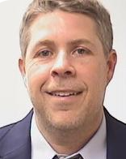
Daniel Beck
Dan Beck joined the Office of General Counsel as an Associate General Counsel in the Compliance Group in fall of 2022. Dan handles all aspects of legal advice related to public safety matters, including compliance with applicable federal, state, and local regulations related to public safety, and facilities and emergency management, and development of relevant University policies.
Before joining JHU, Dan served as the Chief Counsel for the Pennsylvania State Police. In that position, his duties included advising the executive staff on all manner of legal matters, managing civil rights and tort litigation, handling labor disputes and employee disciplinary hearings, developing agency rules and regulations, and representing the department in complex federal litigation.
Before his appointment as Chief Counsel for Pennsylvania State Police, Dan served as Chief Counsel of the Police Legal Affairs Division of the Baltimore City Department of Law. In addition to his other responsibilities in that role, Dan worked directly with attorneys from the U.S. Department of Justice and the Monitoring Team, appointed by the U.S. District Court of Maryland, to implement the reforms mandated by the Consent Decree entered into between the City of Baltimore, the Baltimore Police Department and the Department of Justice.
Dan’s prior legal experience also includes serving as an Assistant State’s Attorney in the Office of the State’s Attorney for Baltimore City.
Dan received his Bachelor of Science in Business Administration from Towson University and his Juris Doctorate from University of Baltimore School of Law.

Slide 72
Maryland’s Open Meetings Act (OMA)
Legislature’s Policy Statement
It is essential to the maintenance of a democratic society that, except in special and appropriate circumstances:
(1) public business be performed in an open and public
manner; and
(2) citizens be allowed to observe:
(i) the performance of public officials; and
(ii) the deliberations and decisions that the
making of public policy involves.
GP § 3-102

Slide 73
Maryland’s Open Meetings Act (OMA)
How Do Meetings Comply with the OMA?
Before: Provide advance public notice and an agenda
During: Hold meeting open to public
After: Prepare minutes
Designate a trainee

Slide 74
Maryland’s Open Meetings Act (OMA)
Meetings
In-person meetings are not always required for an Open Meeting
Deliberation or consideration on items of public business among a quorum requires public access to observe (or listen)
The Board has held that conference calls can satisfy the Open Meeting Act requirements for public access
  Must be accessible to the public
  The public must be able to hear all comments and discussion

Slide 75
Maryland’s Open Meetings Act (OMA)
Virtual Meetings
The Board has held that the Open Meeting allows conference calls
Virtual or online meeting satisfying the same requirements can also comply with the Open Meetings Act
  Electronic online – Zoom, Skype, Google Hangouts, etc.
  In person with live-feed for remote public observation
  Recommend including the conference call option for persons without computer or tablet access
Virtual meetings have been needed during the COVID-19 crisis, but use is likely to continue to allow broader access in the future

Slide 76
Maryland’s Open Meetings Act (OMA)
Activities Governed - Those of a “Public Body” §3-101(H)
Multi-member
Formal creation (law, charter, bylaw, rule, resolution)
By executive appointment, if including 2 or more members of the public
Committees and subcommittees (depending on creation)
Informally created public bodies (sometimes)
Nominally private corporations (sometimes)

Slide 77
Maryland’s Open Meetings Act (OMA)
Activities Governed - What is a Meeting? §§3-101(G), (K), 3-103
Meeting: defined as any deliberation, consideration or transaction of public business among a quorum
  Quorum counts anyone present – can’t cycle through a room to evade the Act
Conference calls or any other method of simultaneous or contemporaneous interaction
  Electronic communications allowing continued and interactive group deliberation on public business
  Virtual meetings on Zoom, Google Hangouts, or others
Social gatherings and retreats when public business is discussed
  Not social gatherings when no public business is discussed

Slide 78
Maryland’s Open Meetings Act (OMA)
Electronic (E-Mail) Exchange of Information without Deliberation
Transmitting information by email, text, etc. , without discussion or deliberation, is generally acceptable
  The public has the right to observe deliberations on public business covered by the Act
Public business includes any consideration of a public matter, including decisions, recommendations, requests and opinions
  This includes proclamations, awards and officers of the public body (such as chair, vice-chair and secretary)
Email (outside of a public meeting) can be used to:
  Approve minutes and agenda items
  Identify meeting locations, times, and agenda
  Provide information without deliberation by the public body

Slide 79
Maryland’s Open Meetings Act (OMA)
Electronic (E-Mail) Deliberations on Public Business
Emails (or texts) used by a quorum to deliberate and decide matters of public business may violate the Act
Try to avoid the following “red flags”:
  “Reply-all” and group/circulated email exchanges, especially when there is discussion and deliberation
  Continuous deliberation on a matter leading to a decision
  Effectively constant messages even if not simultaneous

Slide 80
Maryland’s Open Meetings Act (OMA)
Options for Urgent Matters of Public Business
Options for urgent matters may include:
  A public meeting by conference call (allowing the public to dial in) after public notice
  Individual emails to each member of the public body
    Without interactive deliberation
  Scheduling an online public meeting and allowing public to observe
  Delegating the decision to staff and/or one member of the public body (or the Mayor or equivalent role)
Note: The Open Meetings Act prohibits “evasive devices” to avoid compliance

Slide 81
Maryland’s Open Meetings Act (OMA)
Activities Governed -Topics of Discussion (“Functions”) Defined by the Act §§ 3-101 Definitions; 3-103 Scope
Covered: Advisory, legislative, quasi-legislative functions, all as specially defined by the Act
Expressly included: discussions concerning
  Granting a license or permit
  Many types of land-use matters
Excluded: administrative (formerly executive), judicial, quasi-judicial functions

Slide 82
Maryland’s Open Meetings Act (OMA)
Virtual Meeting Preparation
Advance meeting preparation may be an “administrative function” not subject to Open Meetings Act requirements – BUT ONLY IF:
  Discussions are limited to practical and technical matters as to how to access and operate the meeting, such as:
    Details of the virtual meeting process
    Protocols during the meeting
    Setting the agenda
If so limited, the meeting for advance preparation does not require notice, motion to close, or minutes unless the meeting occurs in the midst of an otherwise open meeting or at the end of such a meeting
The Administrative function exemption does not allow discussion on the creation of public policy, per GP § § 3-101 and 103

Slide 83
Maryland’s Open Meetings Act (OMA)
Running a Virtual Public Meeting
The COVID-19 crisis required all of us to learn new ways of proceeding
Remember proceed with clear steps
  Start with a roll call to identify public body members who are present
  Speakers should identify themselves before speaking
  Chair should be careful to recognize speakers by name
  If virtual (visual), raising hands can be helpful before speaking
Motions should be deliberate
  If visual, raise hands to make the motion and second
  Voting should be member-by-member to avoid confusion
  Chair should announce motion, second, and voting
Chair needs to deliberately announce each new agenda item

Slide 84
Maryland’s Open Meetings Act (OMA)
Actions Before a Meeting: Public Notice of Meetings - § 3-302
Timing
  Reasonably in advance
Last-minute meetings – make special efforts
Content
Date, time, place, open/then closed status (vote to close is public)
Agenda
  Make available in advance, with topics and items of business
Method
Consistency

Slide 85
Maryland’s Open Meetings Act (OMA)
Advance Notice for Virtual Meetings
When not using customary and usual practices for a meeting, make extra efforts to provide notice
Notice must tell the public how to access the meeting for observation
Recommend making a conference call option available to ensure public access and as a backup
Advance notice is critical, and to the extent possible, using the same notice process is recommended

Slide 86
Maryland’s Open Meetings Act (OMA)
Actions During a Meeting: Logistics - § 3-303
Location
Public participation – not required by Act
Cameras/tape recorders – model rules recommended
Documents and communications referred to during meeting- ensuring access
Audible discussion (no quiet discussions among public body members which cannot be heard)

Slide 87
Maryland’s Open Meetings Act (OMA)
Providing Public Access for a Virtual Meeting
Meetings must be reasonably accessible to the public
Reasonable means accessible to the community being served
  This requires consideration of how the community can access the meeting and whether they have the means to do so
  For example, a Zoom meeting without a conference call option may not be considered accessible for a community where few persons have computer access
For a conference call – a telephone number to call, along with any access codes
For electronic online – an access code to allow live participation, with a telephone number to allow listening (as an option OR upon software failure)
  Additional registration or sign-in can be required to provide public comment, but not for public access simply to observe
To ensure maximum public access, an electronic online meeting can also be shown live via internet, cable access, You-Tube, etc.
Note that providing a conference call option even as a backup, will help:
  Ensure accessibility even for those without online access
  Allow a practical backup even if online access becomes interrupted
  Ensure Open Meetings compliance if there is a future challenge

Slide 88
Maryland’s Open Meetings Act (OMA)
Actions During a Meeting: 15 Exceptions (All to be construed narrowly) – GP § 3-305(B)
Personnel matters regarding individual employees
Receipt of legal advice
Litigation
Real property acquisition (not sale)
Collective bargaining
Certain business development proposals
Certain public security matters
Cyber security: If identified risk to information resources or network management
Other law requiring confidentiality…and 6 others

Slide 89
Maryland’s Open Meetings Act (OMA)
Actions During a Meeting: Closing a Meeting - § 3-305 – 306(C), -104
Identifying a specific exception allowing closure
Chair completes a meaningful written “closing statement” – citation, topic, reasons for excluding public; Chair’s duty to prepare/sign it
Holding a public vote to close, after proper notice of the open session
Staying within the exception on the statement
Deciding on post-meeting disclosures (what members will say)
2 model closing statements on Attorney General’s website
Complying with training requirements; completing Compliance Checklist if member designated for training can’t attend.
Closed session impermissible if public body hasn’t designated a member for training. § 3-213.

Slide 90
Maryland’s Open Meetings Act (OMA)
Open Meetings Act: Public Participation
Act does not require public participation
  BUT, public participation MAY be otherwise required
    For public hearings
    For a period of open public comment (if provided)
    Where other specific requirements apply
Use consistent processes to allow equal access for public comment
  For a virtual meeting, registration or sign-in is permitted to establish an order for public comment
  Scheduling allows comment “in the order received”
  Can allow email comment prior to the meeting or leave record open
Focus should be on maximizing opportunity for public comment, such as by scheduled oral comment and an email option as well
Right of cross-examination and contentions hearings will be special challenges in a virtual setting

Slide 91
Maryland’s Open Meetings Act (OMA)
Actions After a Meeting: Meaningful Minutes - § 3-306
Required timeliness; content
Open-session minutes: available on request, without redaction
  Post online if “practicable,” per §3-306(e)(2)
Closed session minutes are sealed, with the public summary included in the minutes of next open session
  Note this requirement also extends to certain administrative function sessions not open to public
  Summary of closed session with 4 required items of information (date-time-place, purpose; vote record to close; citation allowing closure; topics discussed, persons present, any action taken) and compliance checklist, if required per §3-213
Tape recording ≠ minutes, but use of live and streaming audio or video can be allowed for open-session minutes

Slide 92
Maryland’s Open Meetings Act (OMA)
Actions After a Meeting: Meaningful Minutes - § 3-104 and § 306
Minutes of the next open meeting must include:
  Purpose for the closed meeting
  Citation authorizing closed meeting
  Votes to close
  Topics and subject matter actually discussed
  Actions taken (if any)
  Date, time, place
  Persons present
For a template, go to open meetings page on Attorney General’s website
Only exception -- §3-104: closing an open meeting for the administrative function. Minutes must include (1) the subject matter discussed, (2) date/time/place and (3) persons present

Slide 93
Maryland’s Open Meetings Act (OMA)
Actions After a Meeting: Record Retention - § 3-302 and § 3-306
Notice (screenshot of online notice should be printed to include date of posting) (1 year)
Minutes and tape recordings (5 years)
Sealed minutes (1 year)
Closing statements (likely 1 year)
Archiving requirements - other laws might apply
Access: open to inspection at the office on request
  Minutes to be posted online to the extent “practicable”

Slide 94
Maryland’s Open Meetings Act (OMA)
Remedies – 2 Routes
Open Meetings Compliance Board: Advisory opinions – §§ 3-204 through 3-212
When OMCB finds violation, public body must summarize the opinion at the next public meeting, sign it, and return it to the Compliance Board
2. Circuit Court: Orders – §§ 3-401 and 3-402
Court may overturn public body’s action in some cases, assess penalty, and award attorney’s fees

Slide 95
Maryland’s Open Meetings Act (OMA)
Training Requirement - § 3-213
Designation by “each public body” of a member, officer, or employee to receive training
Designee must take training within 90 days of the designation
  Training received before October 1, 2013, does not qualify
If the designee no longer serves on or works for the public body, the public body needs to designate a new designee

Slide 96
Maryland’s Open Meetings Act (OMA)
Additional Training Requirement - § 3-213
Public body may not meet in closed session unless a member has been designated to take the training
Designated member should attend open session at which public body votes to hold closed session,
  If not, public body must complete Compliance Checklist and attach it to open-session minutes
Public bodies should retain their own proof that the training was received and not send it to the Compliance Board

Slide 97
Maryland’s Open Meetings Act (OMA)
Issues, Examples, and Questions
Common causes of violations (unplanned meetings, lack of staff, staff/member turnover, member desire to control information, lack of knowledge about the Act’s requirements, lack of agenda planning)
Steps to avoid complaints
  Identify the person responsible for various compliance tasks
      Include tasks in job descriptions
  Adopt schedule for training
  Plan meeting topics
  Orient new members and staff
Avoidance of electronic or other non-public communications which include deliberation and/or decision on public matters by a quorum
Responses to complaints (see the procedures posted online)- addressing constituents’ concerns early

Slide 98
Maryland’s Open Meetings Act (OMA)
More Information
Compliance checklist, model closing forms and summary, FAQs, Compliance Board opinions, and topical index:
  http://www.marylandattorneygeneral.gov/Pages/OpenGov/Openmeetings/default.aspx
For virtual meetings, the above Attorney General “Open Meetings” page has an FAQ and the Maryland Municipal League has a 1-page summary www.mdmunicipal.org
Online class: Institute for Governmental Service and Research website: www.igsr.umd.edu
Open Meetings Act Manual (10th ed. 2021), also accessible through the Attorney General’s “Open Meetings” page

