Slide 1
JHU Accountability Board
Board Retreat and Values Exploration
©Kei-Impact Group, LLC 2022

Slide 2
The session frame
Values are our motivating and organizing principles, often provided for us through socialization experiences in our families, communities, and the larger society.
Values guide our beliefs, standards, judgments, and motivations.
Most of us don’t have the luxury of identifying them let alone identifying the values we share with others when working in teams and groups
©Kei-Impact Group, LLC 2022

Slide 3
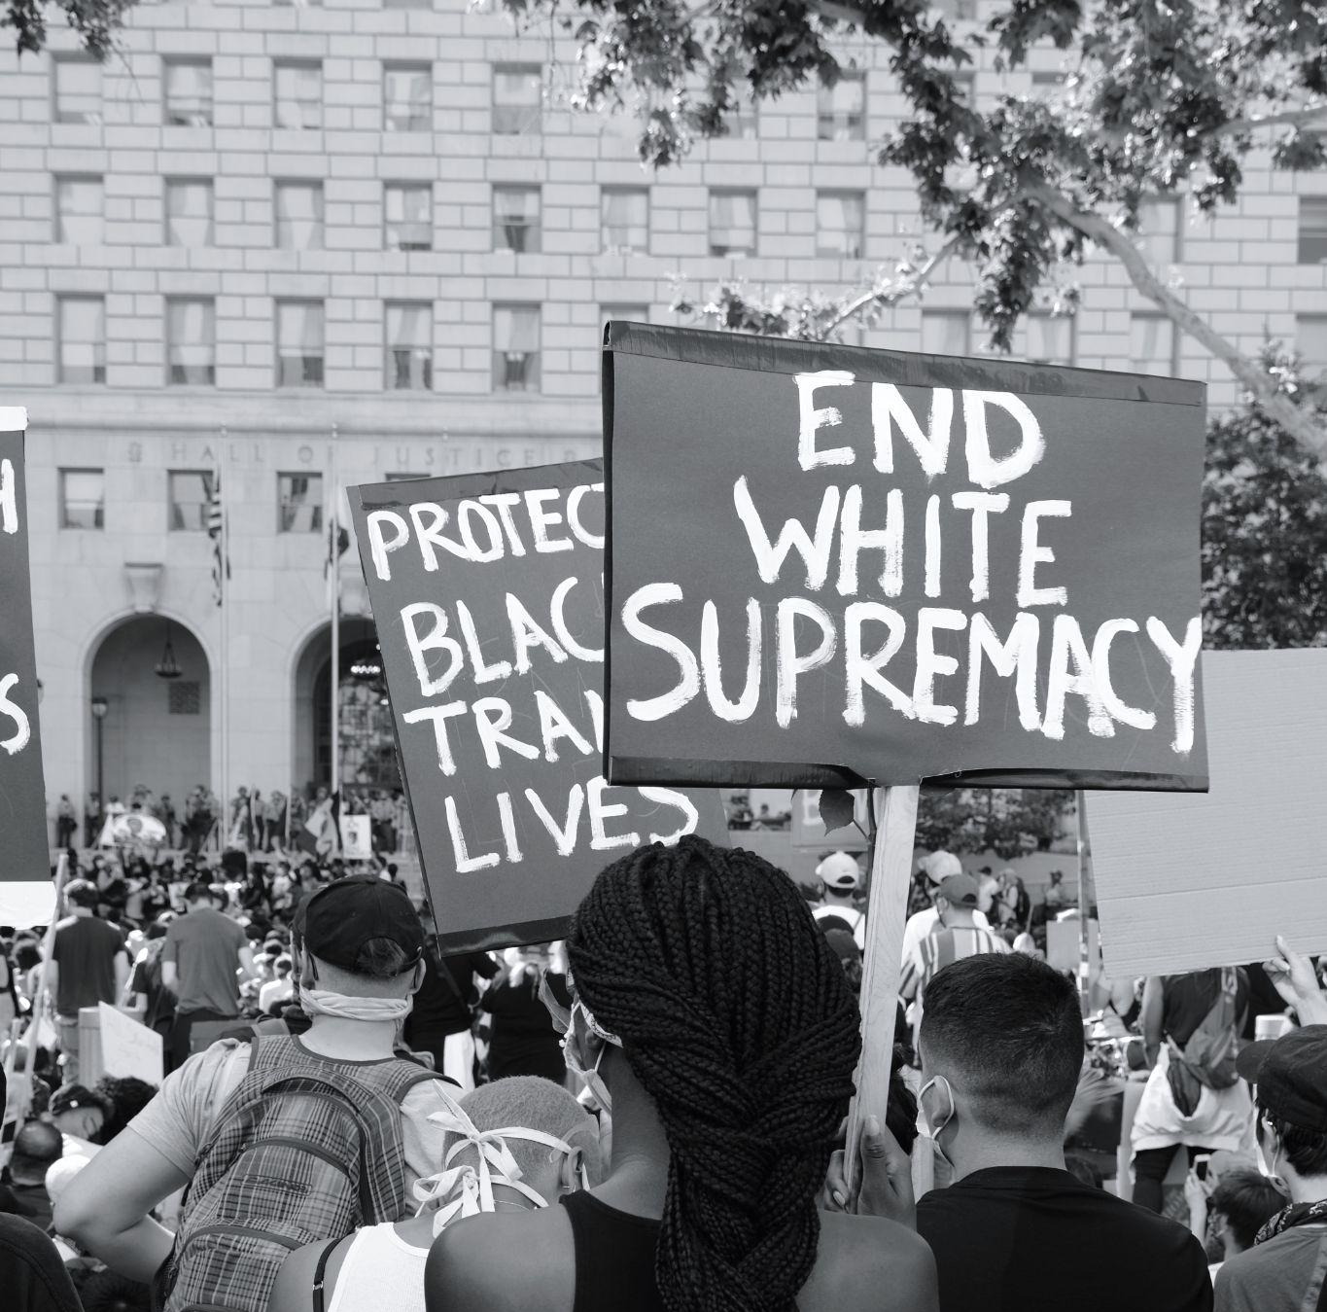
Who was at the table
Answer the question, “Why are we the ones to solve the problem we identified?”
People who are committed to learning and change.
People who are committed to systems of care and accountability.
People who are committed to naming and framing what is possible.
People committed to protecting and guiding the future of the Baltimore Community.
©Kei-Impact Group, LLC 2022

Slide 4
Goal: Develop shared values that will help us understand what we are collectively motivated
©Kei-Impact Group, LLC 2022

Slide 5
Individual values brought into focus
God’s Will
Family
Gratitude
Autonomy
Service
Integrity Achievement
Tolerance
Accuracy
Justice
Genuineness
Caring
Stability
Dependability
Flexibility
Non-conformity
Integrity
©Kei-Impact Group, LLC 2022

Slide 6
Justice
Shared Values
Genuineness
Caring
Stability/ Dependability
There are the values the group held that were similar or in relationship to each other.
©Kei-Impact Group, LLC 2022

Slide 7
Shared Agreements
Shared agreements
Identify how we agree to be together. They are shaped by our values.
Agreements are the guidepost and standards we set for “how we will be together”.
Share agreements build the container for our charred culture, how we will work, and can be the ideas we come back to when we arrive at conflict, challenge, or integrating new members.
©Kei-Impact Group, LLC 2022

Slide 8
Shared Agreements: We agree to be
Committed to Collective Safety
Collaborative and Unified
Learners
Rooted in: Justice | Genuineness | Caring | Stability/ Dependability
Focused on the safety and well-being of the community.
Design actions in such a way, the members of the groups are protected from/ insulated while experiencing retaliation.
Create space for clarity, direction, and shared decision-making.
Stand together once a decision is made.
Utilize what is learned to guide what is possible.
©Kei-Impact Group, LLC 2022

Slide 9
The group identified task guided by values and accomplished through agreements
Create A backbone
Internal structure for managing communications information sharing, and external request
Manage emails, meeting details, etc.
Communication/ Marketing strategy
Build a clear identity
Communicate that identity
Manage the external message
Create a Plan & Stick to it
What does the group want to accomplish
Who will take ownership
What does the process/ outcome look like?
Get clear on the desired design and the collective design of the board
What does the legislation say?
What does the group agree with/ disagree with
Get organized:
Develop a structure for the group/ the meetings and how decisions are made
Commit at the level of capacity
Learn board capacity
Learn individual capacity
©Kei-Impact Group, LLC 2022

Slide 10
Sonya
Cynthia
Terri
Doris
Lori
Micheal
Edward
LaTicia
Gus
Gratitude
to those who came to the retreat and contributed to this content.

Slide 11
Provided by:
Keilah A. Jacques
Kei-Impact Group
Keilah.Jacques@gmail.com

