Slide 1
Johns Hopkins Accountability Board
Orientation
June 14, 2024

Slide 2
Agenda
8:30 a.m. – Arrival and Breakfast
9:00 a.m. – Opening Remarks
9:05 a.m. – Introductions & Icebreaker
9:40 a.m. – Community Safety and Strengthening Act (CSSA)
10:20 am – Maryland Open Meetings Act (OMA)
10:50 a.m. – 10-Minute Break
11:00 a.m. – Policy Overview
11:20 p.m. – Committee Overviews
11:50 p.m. – 20-Minute Break to Grab Lunch
12:10 p.m. – Bylaws Review
1:30 p.m. – Break
1:35 p.m. – Questions and Next Steps
1:50 p.m. – Closing Remarks

Slide 3
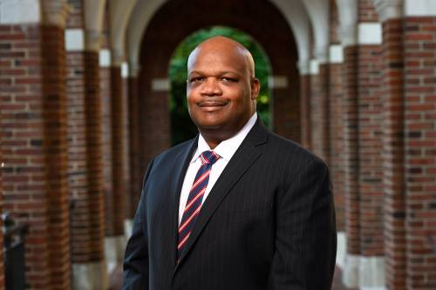
Dr. Branville G. Bard, Jr. Vice President for Public Safety and Chief of the Johns Hopkins Police Department (JHPD)

Slide 4
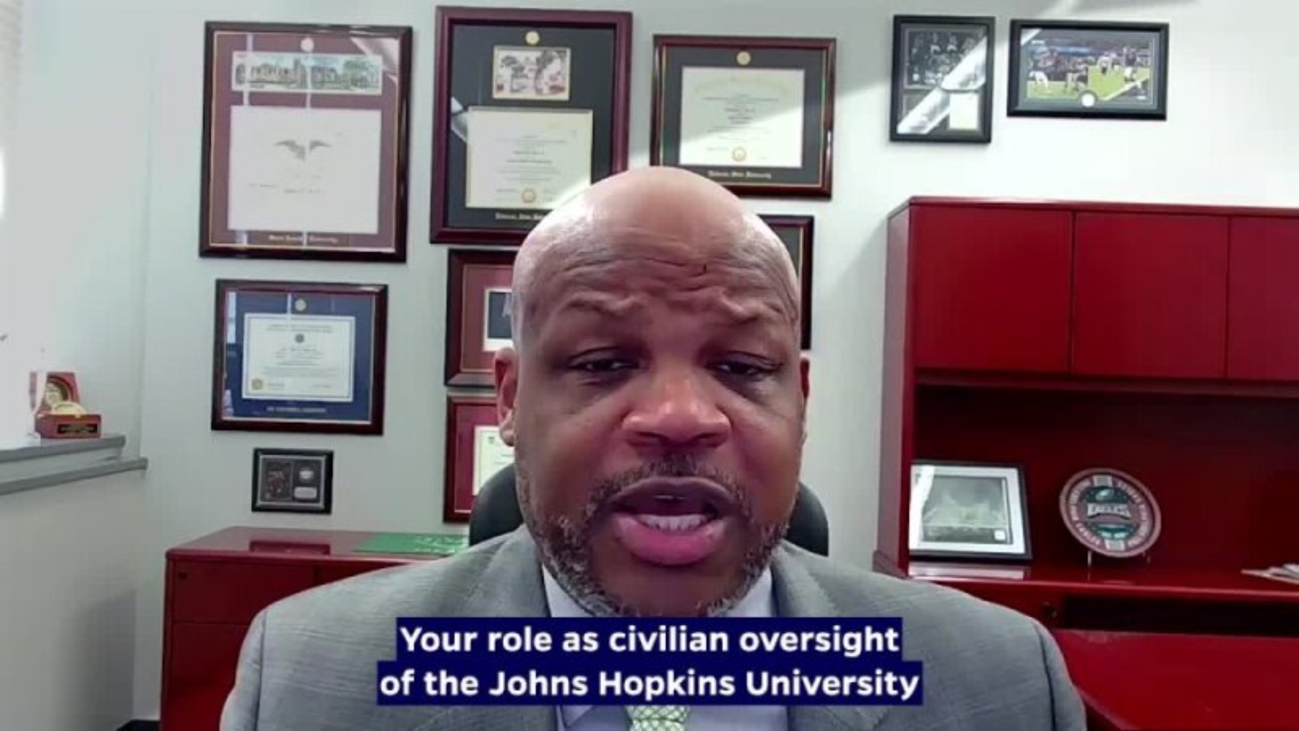
Dr. Branville G. Bard, Jr. Vice President for Public Safety and Chief of the Johns Hopkins Police Department (JHPD)

Slide 5
Edward “Ed” Kangethe – Chair
Calvin L. Smith Jr. – Deputy Chief of Staff for Public Safety
Welcome/Introductions

Slide 6
Community Safety and Strengthening Act
Ganesha Martin

Slide 7
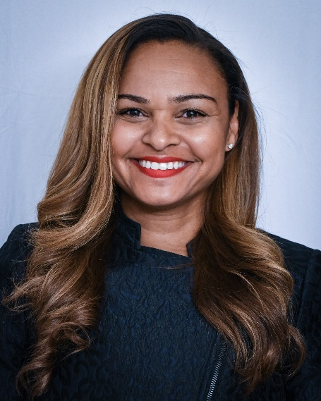
Ganesha Martin
Ganesha Martin, Esq. is a police reform expert that recently joined Mark43, the leading cloud-native public safety software company, as Vice President of Public Policy and Community Affairs. In her role, Martin focuses on Mark43’s ongoing commitment to innovation in technology designed to empower police to better serve their communities through accountability, transparency and trust-building. Prior to this role, she served in several positions in Baltimore City government. Most recently she was the Director of the Mayor’s Office of Criminal Justice (MOCJ). She has overseen collaborative criminal justice efforts that included the Baltimore Police Department, Baltimore State’s Attorney’s Office, Governor’s Office of Crime Control and Prevention, Department of Justice Civil Rights Division, U.S. Attorney’s Office, the judiciary and several community groups.
In her current consulting practice, Martin focuses on uniting communities of color and the police who swear to serve and protect them. Her unique ability to connect with both the community and police before guiding them towards common ground is the hallmark to her success. In addition to Baltimore, she has consulted on consent decree compliance and police reform matters for police departments across the country. An expert on public safety, best practices for building relationships between community and police, she regularly advises nonprofit organizations, real estate developers, tech startups, private corporations, community groups and local governments.
A highly sought-after expert on police reform, Martin regularly speaks on DOJ Consent Decrees, police reform and accountability, and public safety. She’s a member of the Council on Criminal Justice, an invite-only, nonpartisan organization and think tank for leaders in the criminal justice field. She was recently elected to the Board of Directors for the National Criminal Justice Association. In 2019 she was one of 40 community policing experts invited to Nairobi, Kenya to share community policing strategies during the Convening on Civilian Police Reform by Open Societies Foundation. She was also awarded their Securing Open Societies Fellowship in 2019. Martin’s expert commentary has been featured in The New York Times, The Baltimore Sun, USA Today and the Washington Post among others.

Slide 8
Community Safety and Strengthening Act
Overview
Chapter 25 of 2019 (Senate Bill 793)
Took effect July 1, 2019
Two main components:
  Community investments to help address root causes of crime; and
  Authorization for the Johns Hopkins Police Department

Slide 9
Community Safety and Strengthening Act
JHPD Operations
Police Department established based on MOU between JHU and the Baltimore Police Department with community input
Department may operate on East Baltimore, Homewood, and Peabody campuses
May operate in areas adjacent to campus ONLY IF:
Receive a majority of support from relevant community; and
  Baltimore City Council approves a resolution affirming JHU has received the required support of the community
  Subject to standards to ensure constitutional and community-oriented policing

Slide 10
Community Safety and Strengthening Act
Public Accountability
Must establish a University Police Accountability Board
  Fifteen-member board with five seats for community
  Will review department metrics and policies and make recommendations
Subject to jurisdiction of the Civilian Review Board of Baltimore City
Disciplinary hearing board must have two voting members of the public
Must establish a public complaint process
No civil immunity in department court cases

Slide 11
Community Safety and Strengthening Act
Role of the Johns Hopkins Accountability Board
Has authority to:
  (1) Review JHPD metrics involving crime
  (2) Review current/prospective PD policies, procedures, training
  (3) Provide recommendations to JHU on the above
Must meet at least quarterly
Must post its meeting minutes prominently on a public website
Must hold at least one public meeting annually “to seek input on police department policies, procedures, and training from community members of Baltimore City”
Once JHPD is established, it must acknowledge and respond to any recommendation from the Board within 120 days

Slide 12
Maryland Open Meetings Act (OMA)
Daniel Beck

Slide 13
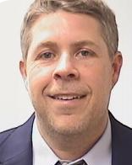
Daniel Beck
Dan Beck joined the Office of General Counsel as an Associate General Counsel in the Compliance Group in fall of 2022. Dan handles all aspects of legal advice related to public safety matters, including compliance with applicable federal, state, and local regulations related to public safety, and facilities and emergency management, and development of relevant University policies.
Before joining JHU, Dan served as the Chief Counsel for the Pennsylvania State Police. In that position, his duties included advising the executive staff on all manner of legal matters, managing civil rights and tort litigation, handling labor disputes and employee disciplinary hearings, developing agency rules and regulations, and representing the department in complex federal litigation.
Before his appointment as Chief Counsel for Pennsylvania State Police, Dan served as Chief Counsel of the Police Legal Affairs Division of the Baltimore City Department of Law. In addition to his other responsibilities in that role, Dan worked directly with attorneys from the U.S. Department of Justice and the Monitoring Team, appointed by the U.S. District Court of Maryland, to implement the reforms mandated by the Consent Decree entered into between the City of Baltimore, the Baltimore Police Department and the Department of Justice.
Dan’s prior legal experience also includes serving as an Assistant State’s Attorney in the Office of the State’s Attorney for Baltimore City.
Dan received his Bachelor of Science in Business Administration from Towson University and his Juris Doctorate from University of Baltimore School of Law.

Slide 14
Maryland’s Open Meetings Act (OMA)
Legislature’s Policy Statement
It is essential to the maintenance of a democratic society that, except in special and appropriate circumstances:
(1) public business be performed in an open and public
manner; and
(2) citizens be allowed to observe:
(i) the performance of public officials; and
(ii) the deliberations and decisions that the
making of public policy involves.
GP § 3-102

Slide 15
Maryland’s Open Meetings Act (OMA)
How Do Meetings Comply with the OMA?
Before: Provide advance public notice and an agenda
During: Hold meeting open to public
After: Prepare minutes
Designate a trainee

Slide 16
Maryland’s Open Meetings Act (OMA)
Meetings
In-person meetings are not always required for an Open Meeting
Deliberation or consideration on items of public business among a quorum requires public access to observe (or listen)
The Board has held that conference calls can satisfy the Open Meeting Act requirements for public access
  Must be accessible to the public
  The public must be able to hear all comments and discussion

Slide 17
Maryland’s Open Meetings Act (OMA)
Virtual Meetings
The Board has held that the Open Meeting allows conference calls
Virtual or online meeting satisfying the same requirements can also comply with the Open Meetings Act
  Electronic online – Zoom, Skype, Google Hangouts, etc.
  In person with live-feed for remote public observation
  Recommend including the conference call option for persons without computer or tablet access
Virtual meetings have been needed during the COVID-19 crisis, but use is likely to continue to allow broader access in the future

Slide 18
Maryland’s Open Meetings Act (OMA)
Activities Governed - Those of a “Public Body” §3-101(H)
Multi-member
Formal creation (law, charter, bylaw, rule, resolution)
By executive appointment, if including 2 or more members of the public
Committees and subcommittees (depending on creation)
Informally created public bodies (sometimes)
Nominally private corporations (sometimes)

Slide 19
Maryland’s Open Meetings Act (OMA)
Activities Governed - What is a Meeting? §§3-101(G), (K), 3-103
Meeting: defined as any deliberation, consideration or transaction of public business among a quorum
  Quorum counts anyone present – can’t cycle through a room to evade the Act
Conference calls or any other method of simultaneous or contemporaneous interaction
  Electronic communications allowing continued and interactive group deliberation on public business
  Virtual meetings on Zoom, Google Hangouts, or others
Social gatherings and retreats when public business is discussed
  Not social gatherings when no public business is discussed

Slide 20
Maryland’s Open Meetings Act (OMA)
Electronic (E-Mail) Exchange of Information without Deliberation
Transmitting information by email, text, etc. , without discussion or deliberation, is generally acceptable
  The public has the right to observe deliberations on public business covered by the Act
Public business includes any consideration of a public matter, including decisions, recommendations, requests and opinions
  This includes proclamations, awards and officers of the public body (such as chair, vice-chair and secretary)
Email (outside of a public meeting) can be used to:
  Approve minutes and agenda items
  Identify meeting locations, times, and agenda
  Provide information without deliberation by the public body

Slide 21
Maryland’s Open Meetings Act (OMA)
Electronic (E-Mail) Deliberations on Public Business
Emails (or texts) used by a quorum to deliberate and decide matters of public business may violate the Act
Try to avoid the following “red flags”:
  “Reply-all” and group/circulated email exchanges, especially when there is discussion and deliberation
  Continuous deliberation on a matter leading to a decision
  Effectively constant messages even if not simultaneous

Slide 22
Maryland’s Open Meetings Act (OMA)
Options for Urgent Matters of Public Business
Options for urgent matters may include:
  A public meeting by conference call (allowing the public to dial in) after public notice
  Individual emails to each member of the public body
    Without interactive deliberation
  Scheduling an online public meeting and allowing public to observe
  Delegating the decision to staff and/or one member of the public body (or the Mayor or equivalent role)
Note: The Open Meetings Act prohibits “evasive devices” to avoid compliance

Slide 23
Maryland’s Open Meetings Act (OMA)
Activities Governed -Topics of Discussion (“Functions”) Defined by the Act §§ 3-101 Definitions; 3-103 Scope
Covered: Advisory, legislative, quasi-legislative functions, all as specially defined by the Act
Expressly included: discussions concerning
  Granting a license or permit
  Many types of land-use matters
Excluded: administrative (formerly executive), judicial, quasi-judicial functions

Slide 24
Maryland’s Open Meetings Act (OMA)
Virtual Meeting Preparation
Advance meeting preparation may be an “administrative function” not subject to Open Meetings Act requirements – BUT ONLY IF:
  Discussions are limited to practical and technical matters as to how to access and operate the meeting, such as:
    Details of the virtual meeting process
    Protocols during the meeting
    Setting the agenda
If so limited, the meeting for advance preparation does not require notice, motion to close, or minutes unless the meeting occurs in the midst of an otherwise open meeting or at the end of such a meeting
The Administrative function exemption does not allow discussion on the creation of public policy, per GP § § 3-101 and 103

Slide 25
Maryland’s Open Meetings Act (OMA)
Running a Virtual Public Meeting
The COVID-19 crisis required all of us to learn new ways of proceeding
Remember proceed with clear steps
  Start with a roll call to identify public body members who are present
  Speakers should identify themselves before speaking
  Chair should be careful to recognize speakers by name
  If virtual (visual), raising hands can be helpful before speaking
Motions should be deliberate
  If visual, raise hands to make the motion and second
  Voting should be member-by-member to avoid confusion
  Chair should announce motion, second, and voting
Chair needs to deliberately announce each new agenda item

Slide 26
Maryland’s Open Meetings Act (OMA)
Actions Before a Meeting: Public Notice of Meetings - § 3-302
Timing
  Reasonably in advance
Last-minute meetings – make special efforts
Content
Date, time, place, open/then closed status (vote to close is public)
Agenda
  Make available in advance, with topics and items of business
Method
Consistency

Slide 27
Maryland’s Open Meetings Act (OMA)
Advance Notice for Virtual Meetings
When not using customary and usual practices for a meeting, make extra efforts to provide notice
Notice must tell the public how to access the meeting for observation
Recommend making a conference call option available to ensure public access and as a backup
Advance notice is critical, and to the extent possible, using the same notice process is recommended

Slide 28
Maryland’s Open Meetings Act (OMA)
Actions During a Meeting: Logistics - § 3-303
Location
Public participation – not required by Act
Cameras/tape recorders – model rules recommended
Documents and communications referred to during meeting- ensuring access
Audible discussion (no quiet discussions among public body members which cannot be heard)

Slide 29
Maryland’s Open Meetings Act (OMA)
Providing Public Access for a Virtual Meeting
Meetings must be reasonably accessible to the public
Reasonable means accessible to the community being served
  This requires consideration of how the community can access the meeting and whether they have the means to do so
  For example, a Zoom meeting without a conference call option may not be considered accessible for a community where few persons have computer access
For a conference call – a telephone number to call, along with any access codes
For electronic online – an access code to allow live participation, with a telephone number to allow listening (as an option OR upon software failure)
  Additional registration or sign-in can be required to provide public comment, but not for public access simply to observe
To ensure maximum public access, an electronic online meeting can also be shown live via internet, cable access, You-Tube, etc.
Note that providing a conference call option even as a backup, will help:
  Ensure accessibility even for those without online access
  Allow a practical backup even if online access becomes interrupted
  Ensure Open Meetings compliance if there is a future challenge

Slide 30
Maryland’s Open Meetings Act (OMA)
Actions During a Meeting: 15 Exceptions (All to be construed narrowly) – GP § 3-305(B)
Personnel matters regarding individual employees
Receipt of legal advice
Litigation
Real property acquisition (not sale)
Collective bargaining
Certain business development proposals
Certain public security matters
Cyber security: If identified risk to information resources or network management
Other law requiring confidentiality…and 6 others

Slide 31
Maryland’s Open Meetings Act (OMA)
Actions During a Meeting: Closing a Meeting - § 3-305 – 306(C), -104
Identifying a specific exception allowing closure
Chair completes a meaningful written “closing statement” – citation, topic, reasons for excluding public; Chair’s duty to prepare/sign it
Holding a public vote to close, after proper notice of the open session
Staying within the exception on the statement
Deciding on post-meeting disclosures (what members will say)
2 model closing statements on Attorney General’s website
Complying with training requirements; completing Compliance Checklist if member designated for training can’t attend.
Closed session impermissible if public body hasn’t designated a member for training. § 3-213.

Slide 32
Maryland’s Open Meetings Act (OMA)
Open Meetings Act: Public Participation
Act does not require public participation
  BUT, public participation MAY be otherwise required
    For public hearings
    For a period of open public comment (if provided)
    Where other specific requirements apply
Use consistent processes to allow equal access for public comment
  For a virtual meeting, registration or sign-in is permitted to establish an order for public comment
  Scheduling allows comment “in the order received”
  Can allow email comment prior to the meeting or leave record open
Focus should be on maximizing opportunity for public comment, such as by scheduled oral comment and an email option as well
Right of cross-examination and contentions hearings will be special challenges in a virtual setting

Slide 33
Maryland’s Open Meetings Act (OMA)
Actions After a Meeting: Meaningful Minutes - § 3-306
Required timeliness; content
Open-session minutes: available on request, without redaction
  Post online if “practicable,” per §3-306(e)(2)
Closed session minutes are sealed, with the public summary included in the minutes of next open session
  Note this requirement also extends to certain administrative function sessions not open to public
  Summary of closed session with 4 required items of information (date-time-place, purpose; vote record to close; citation allowing closure; topics discussed, persons present, any action taken) and compliance checklist, if required per §3-213
Tape recording ≠ minutes, but use of live and streaming audio or video can be allowed for open-session minutes

Slide 34
Maryland’s Open Meetings Act (OMA)
Actions After a Meeting: Meaningful Minutes - § 3-104 and § 306
Minutes of the next open meeting must include:
  Purpose for the closed meeting
  Citation authorizing closed meeting
  Votes to close
  Topics and subject matter actually discussed
  Actions taken (if any)
  Date, time, place
  Persons present
For a template, go to open meetings page on Attorney General’s website
Only exception -- §3-104: closing an open meeting for the administrative function. Minutes must include (1) the subject matter discussed, (2) date/time/place and (3) persons present

Slide 35
Maryland’s Open Meetings Act (OMA)
Actions After a Meeting: Record Retention - § 3-302 and § 3-306
Notice (screenshot of online notice should be printed to include date of posting) (1 year)
Minutes and tape recordings (5 years)
Sealed minutes (1 year)
Closing statements (likely 1 year)
Archiving requirements - other laws might apply
Access: open to inspection at the office on request
  Minutes to be posted online to the extent “practicable”

Slide 36
Maryland’s Open Meetings Act (OMA)
Remedies – 2 Routes
Open Meetings Compliance Board: Advisory opinions – §§ 3-204 through 3-212
When OMCB finds violation, public body must summarize the opinion at the next public meeting, sign it, and return it to the Compliance Board
2. Circuit Court: Orders – §§ 3-401 and 3-402
Court may overturn public body’s action in some cases, assess penalty, and award attorney’s fees

Slide 37
Maryland’s Open Meetings Act (OMA)
Training Requirement - § 3-213
Designation by “each public body” of a member, officer, or employee to receive training
Designee must take training within 90 days of the designation
  Training received before October 1, 2013, does not qualify
If the designee no longer serves on or works for the public body, the public body needs to designate a new designee

Slide 38
Maryland’s Open Meetings Act (OMA)
Additional Training Requirement - § 3-213
Public body may not meet in closed session unless a member has been designated to take the training
Designated member should attend open session at which public body votes to hold closed session,
  If not, public body must complete Compliance Checklist and attach it to open-session minutes
Public bodies should retain their own proof that the training was received and not send it to the Compliance Board

Slide 39
Maryland’s Open Meetings Act (OMA)
Issues, Examples, and Questions
Common causes of violations (unplanned meetings, lack of staff, staff/member turnover, member desire to control information, lack of knowledge about the Act’s requirements, lack of agenda planning)
Steps to avoid complaints
  Identify the person responsible for various compliance tasks
      Include tasks in job descriptions
  Adopt schedule for training
  Plan meeting topics
  Orient new members and staff
Avoidance of electronic or other non-public communications which include deliberation and/or decision on public matters by a quorum
Responses to complaints (see the procedures posted online)- addressing constituents’ concerns early

Slide 40
Maryland’s Open Meetings Act (OMA)
More Information
Compliance checklist, model closing forms and summary, FAQs, Compliance Board opinions, and topical index:
  http://www.marylandattorneygeneral.gov/Pages/OpenGov/Openmeetings/default.aspx
For virtual meetings, the above Attorney General “Open Meetings” page has an FAQ and the Maryland Municipal League has a 1-page summary www.mdmunicipal.org
Online class: Institute for Governmental Service and Research website: www.igsr.umd.edu
Open Meetings Act Manual (10th ed. 2021), also accessible through the Attorney General’s “Open Meetings” page

Slide 41
10-Minute Break

Slide 42
Phil Kasten, Sr.
Policy/Training Update

Slide 43
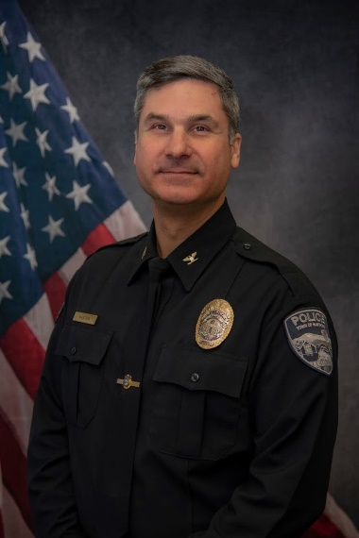
Phil Kasten, Sr.
Phillip Kasten, Sr., currently serves as the senior director of Compliance and Training. In that role, he manages the creation of policies, training, and implementation related to JHPS inclusive of JHPD.
Phil was the Chief of Police for the Town of Hartford, Vermont. Before his appointment, he was Chief Deputy of the Carroll County, Maryland Sheriff’s Office. Rising through the ranks of Carroll County policing, Chief Kasten began his law enforcement career as a Patrolman and later a Sergeant with the Town of Hampstead before joining the County’s growing Sheriff’s Office. Over the past twenty years, Phillip has worked, supervised or managed in all areas of law enforcement.
Chief Kasten has also served as a United States Marine. He holds a Master’s Degree in Criminal Justice and Crime Prevention from the University of Cincinnati and a Bachelor of Arts Degree in Law Enforcement Administration. He is a graduate of the FBI National Academy, Session #233. In addition to holding leadership positions with several professional associations, he has worked as an accreditation manager, assessor, and team leader for CALEA.

Slide 44
Policy Development
Johns Hopkins has undertaken the most extensive policy development and feedback process for a police department at an institution of higher education.
JHPD has focused on policy creation based on best practices and model policies from organizations including the Leadership Conference on Civil and Human Rights, the International Association of Chiefs of Police (IACP), and the Police Executive Research Forum (PERF)
  The ACLU’s “Racially Just Policing: Model Policies for Colleges and Universities”
  The Justice Collaboratory at Yale Law School’s “Principles of Procedurally Just Policing”
  President Obama’s Commission on 21st Century Policing
  The Standards for Law Enforcement Agencies by the Commission on Accreditation for Law Enforcement Agencies (CALEA)
Maryland Police Reform Legislation, Community Safety and Strengthening Act, judicial, The Baltimore City Police Consent Decree and the MOU between the BPD & JHPD

Slide 45


Policy Development & Review Process
Policies reviewed by JH Accountability Board, community, & outside experts
Policies drafted by internal & external policing experts
Policies posted online for a 60- day public comment period
Draft policies are updated to reflect community feedback
Final policies and feedback report posted on the Public Safety Website
JHPD is prioritized and conducted community engagement before policy enactment
9

Slide 46
Policy Development & Review
While some university peers publish finalized policies online, they do not typically post any publicly accessible material regarding their policy development processes.
Each draft policy was prepared by an all Civilian JHPD Policy Drafting Group and was reviewed prior to being shared with the JH Accountability Board and being posted for public review:
  Vice President for Public Safety,
  21CP Solutions, external Public Safety Consultant and
  Key members of the JHU Leadership Team and comment.
First drafts were posted to the JH Public Safety website, with a section for draft review and a prominent feedback button to assist with submitting input.

Slide 47
Policy Review
All draft policies have been and will continue to be shared with the JH Accountability Board prior to the posting of draft policies for public review and comment.
Board members have, and will continue to be invited to share feedback on draft policies in writing and during the Board’s public meetings. We’ve used the following questions to help elicit input,
  Is this policy consistent with the values and needs of the community?
  Does this policy help JHPD safely carry out its stated mission?
  Is this policy understandable? Are there any points that need clarification?
There will also be a page on the JH Public Safety website dedicated to final department policies, in addition to a section for draft review that includes a prominent feedback button to assist with submitting input. All draft policies will be posted on the JH Public Safety website for 60-days to allow for comment.

Slide 48
Policy Development
Feedback and suggestions have been incorporated at every level of review in the policy development process, whenever necessary.
The VP for Public Safety is continuing the review of feedback, and is working with the policy writing team to revise as necessary, and approve policies for implementation and final publication.
  Each finalized and adopted policy, and a feedback report will be posted on the Public Safety website.
  The feedback report will summarize the community engagement process and list all feedback received, as well as a disposition of actionable feedback.
All final policies will be posted on the public safety website and shared with the JH Accountability Board once complete.

Slide 49
Lunch/Bylaws Review

Slide 50
Bylaws
Calvin L. Smith, Jr.

Slide 51
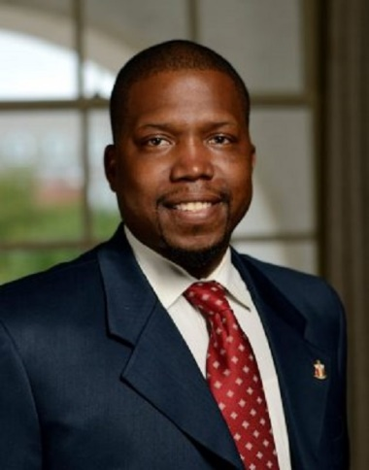
Calvin L. Smith, Jr.
Calvin L. Smith, Jr., currently serves as the deputy chief of staff for Johns Hopkins Public Safety. He manages cross-functional initiatives and advances JHPS's strategic direction, specifically supporting all Johns Hopkins University functions related to Public Safety. Additionally, he is responsible for directly supporting the Johns Hopkins Accountability Board.
Most recently, Calvin led the Leadership Engagement & Experiential Development (LEED) team. He oversaw the LEED office's day-to-day operations, including Leadership Development, Fraternity and Sorority Life, Student Organizations, Student Government Association, Student Lecture Series, Programming Boards, Large-Scale University Programming/Traditions, Protests, and Demonstrations, and the selection, implementation, and expansion of the student engagement platform Hopkins Groups. Calvin worked to ensure students had meaningful opportunities to engage, lead, and develop with the campus and greater Baltimore community through their student organizational experience.
Previously, Calvin was the director of Fraternity and Sorority Life at Johns Hopkins University, an established fraternity and sorority community dating back to 1877. The community currently has over 27 chapters comprised of approximately 1500 students, which makes up 30% of the undergraduate population at JHU. Additionally, he was coordinator of Fraternity and Sorority Life at Towson University. While at Towson, Calvin advised over 34 chapters comprised of approximately 2600 students. He primarily focuses on the overall development and growth of nationally recognized fraternities and sororities on campus. He began his career in pharmaceutical and corporate sales, marketing, and management for six years before transitioning into higher education in the fall of 2011.
Calvin L. Smith, Jr., a Norfolk, Virginia native, holds a B.S. from the Alfred Lerner College of Business and Economics at the University of Delaware and an MBA from the Earl G. Graves School of Business and Management at Morgan State University.

Slide 52
Bylaws
Mission/Charge
Membership
  Membership and Board Composition
  Terms
  Eligibility Requirements
  Appointment Process
  Committee Structure
    Board Secretary
    Officers

Slide 53
Bylaws
Membership Expectations
  National Association for Civilian Oversight of Law Enforcement (NACOLE) Code of Ethics
Meeting Requirements
  Meeting Frequency and Meeting Agendas
    Quarterly Meetings
  Motions
  Debate
  Voting
  Decorum
  Standing Committees
  Maryland Open Meetings Act Compliance and Public Access

Slide 54
Bylaws
Removal and Discipline
Procedural Requirements: Quorum and Voting
  Quorum
  Recusal
Training Commitments
Duties of the Accountability Board
Board Meeting Recordings
Amendments: Board Decision(s)
Policy Review
Annual Meeting with the Johns Hopkins University President
Disclosures

Slide 55
5-Minute Break

Slide 56
Questions/Next Steps
  Next Meeting | July 17th
  Community Engagement Event (East Baltimore) July 20th
  Board Social Event
  Fall 2024
    August – Meeting with President Daniels
    September – Community Relations/Outreach (Peabody, Homewood)
    October – Annual Meeting

Slide 57
Thank You!
If you have any questions, comments, or concerns, please get in touch with Calvin L. Smith Jr.(clsmith@jhu.edu) or Amy Taylor (atayl151@jhu.edu).
We look forward to working with you!

